Slide 1

Women’s Clothing E-Commerce
Analysis of trends and Identification of Potential Improvements
Group 3: - Neal Bates, James Alexander, John Fields, Andrea Bradshaw
Notes:
Women's clothing in e-commerce has particular challenges:
Hard to find clothes that work well with their body type
Women struggle with finding clothes that fit as expected
Sizing variances based on different brands
Can't try on the clothes and return policies can be a pain
Customer reviews are one of the primary sources that aid women in online clothing purchase decisions.

Slide 2
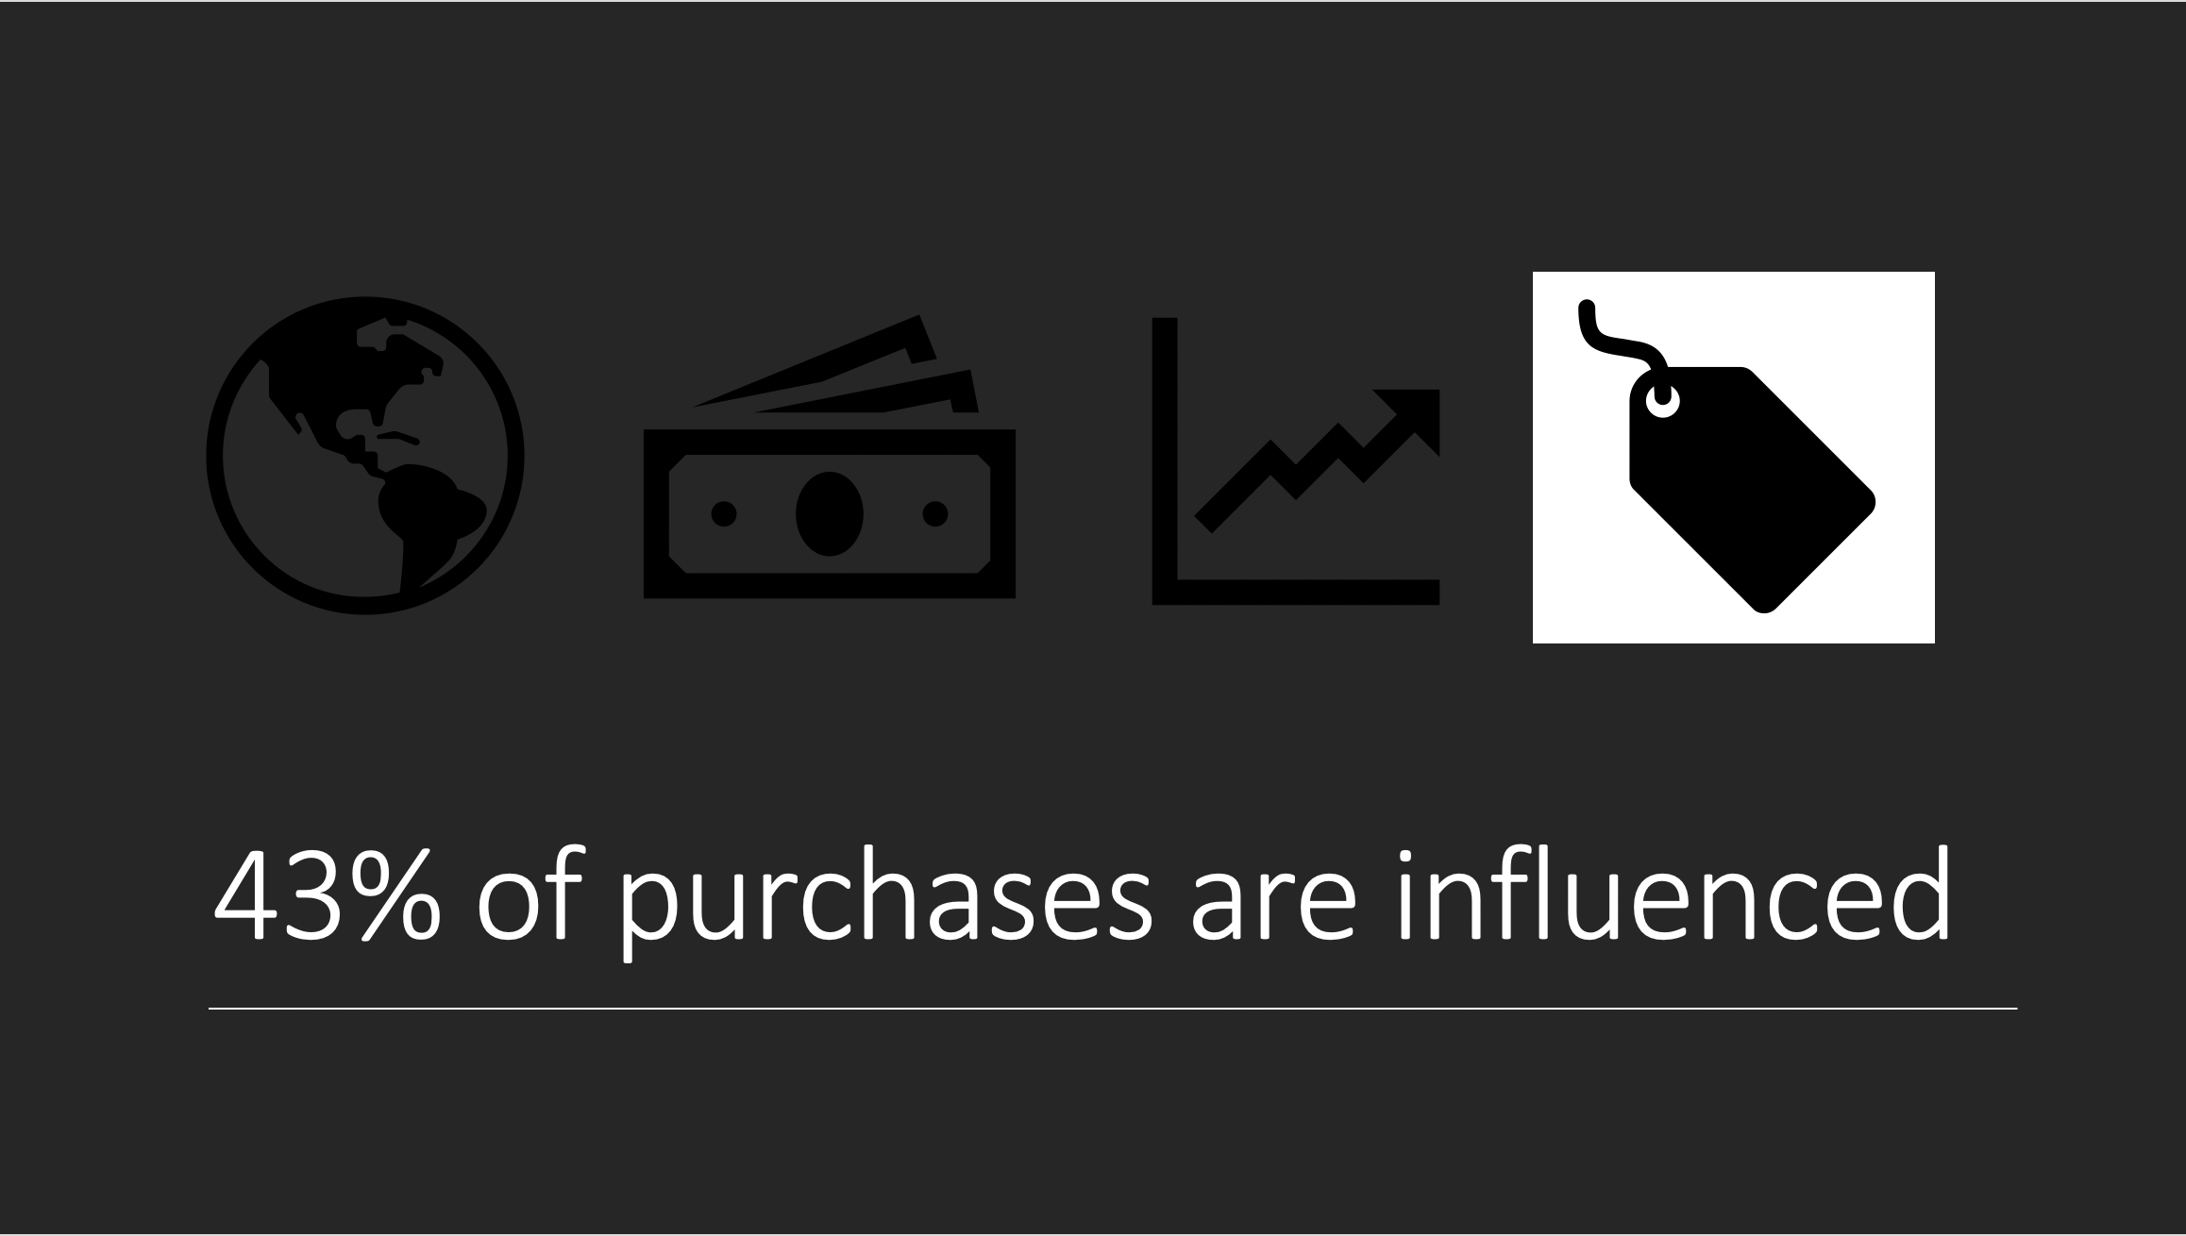
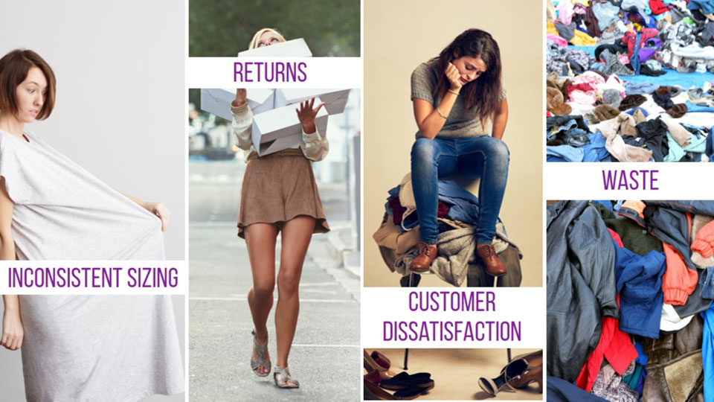

Notes:
Between 86-90% of consumers are influenced by online reviews.​ [Planet Marketing, March 2019]
90% of customers are influenced by positive reviews to purchase both online and in-store​
86% of customers will avoid purchasing a product based on a negative review​
And 88% of people trust online reviews as much as a personal recommendation

Slide 3
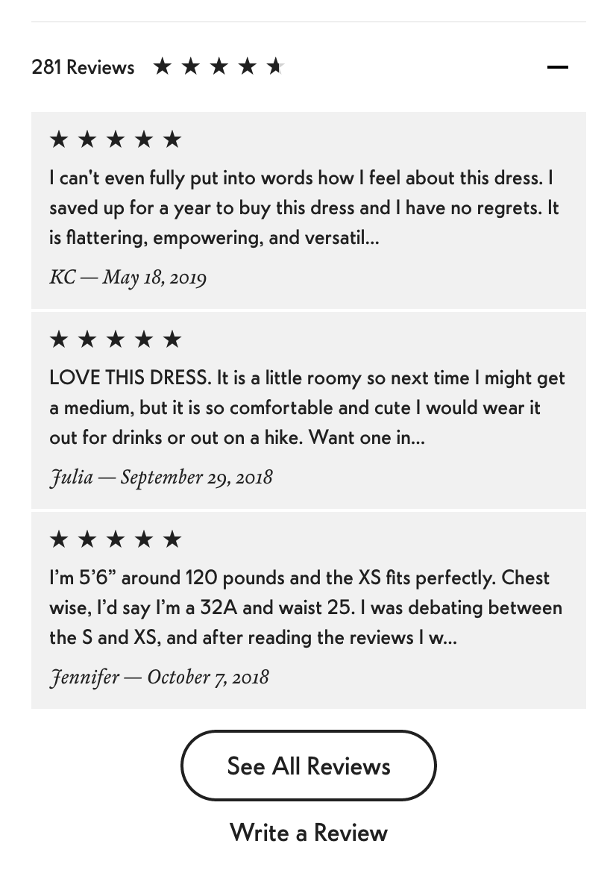
Project Topic: Leveraging Women’s Clothing Reviews for Business Success
SCOPE
Review:
Text Analysis of positive & negative reviews
Age Range Correlations
Customer Perception of Other Customer Reviews
Rating Correlations
Notes:
Review dependence in the area of women's e-commerce allows for analysis and insight that can improve business
performance in this area as well as in broader e-commerce segments that use Customer Reviews.
Approaches used to analyze the impacts of reviews were:
Identifying verbiage that correlates to positive reviews
Identifying Age Range Correlations
Identifying associations between recommendations to purchase and review ratings,
Customer feedback on the helpfulness of reviews.

Slide 4
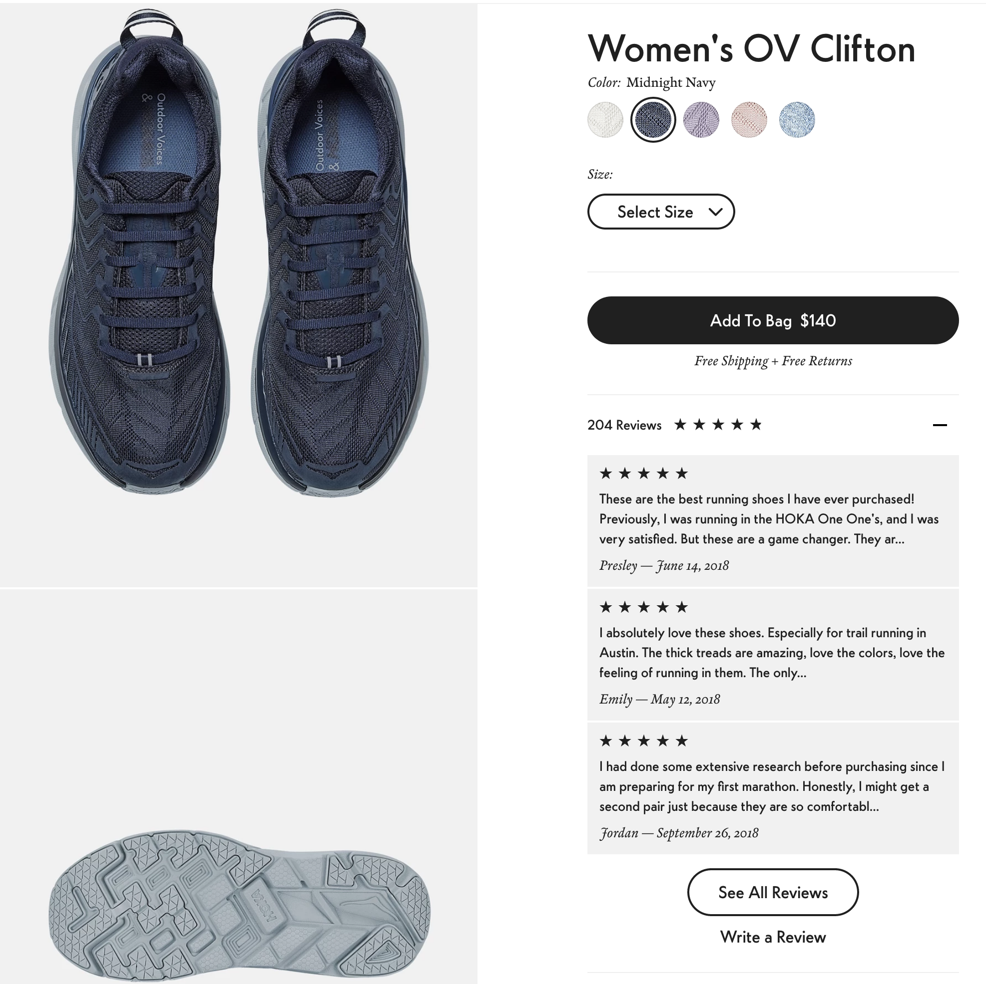
Women’s E-Commerce Clothing Reviews Dataset
This dataset includes 23486 rows and 10 feature variables. Each row corresponds to a customer review, and includes the variables:
Clothing ID: Integer Categorical variable that refers to the specific piece being reviewed.
Age: Positive Integer variable of the reviewers age.
Title: String variable for the title of the review.
Review Text: String variable for the review body.
Rating: Positive Ordinal Integer variable for the product score granted by the customer from 1 Worst, to 5 Best.
Recommended IND: Binary variable stating where the customer recommends the product where 1 is recommended, 0 is not recommended.
Positive Feedback Count: Positive Integer documenting the number of other customers who found this review helpful.
Division Name: Categorical name of the product high level division.
Department Name: Categorical name of the product department name.
Class Name: Categorical name of the product class name.
Example review from a women’s retailer
Data Source: https://www.kaggle.com/nicapotato/womens-ecommerce-clothing-reviews
Notes:
The dataset from Kaggle includes real product reviews that have been anonymized. Anywhere the company name is mentioned the word “retailer” was inserted. Please also notice the definition for Positive Feedback Count which is the number of reviewers who thought a given review was “helpful”.

Slide 5
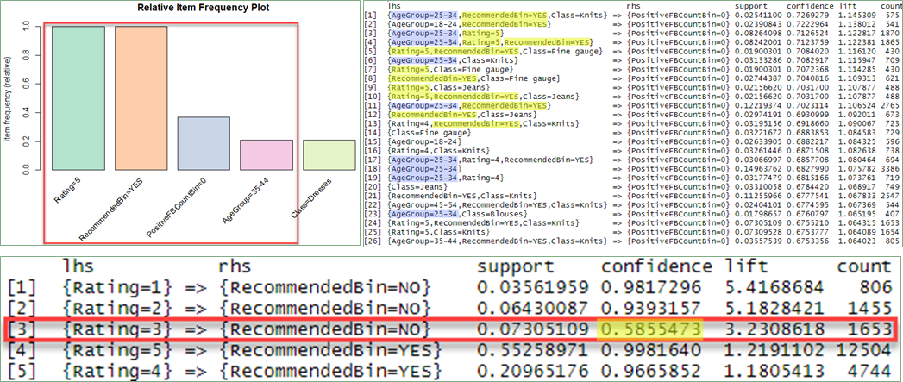
Analysis: Association Rule Mining
Rating = 5 => Recommended = YES
Age Group = 35-44
Ratings = 1, 2 & 3 => Recommended = NO
Rating 1 & 2 = 94-98% confidence/accuracy
Rating 3 = 58.6% confidence/accuracy
Notes:
Ratings 1 & 2 strongly associated w/ Recommendation of NO.
Rating of 3 had confidence level/accuracy of 58.6% of association w/ a Recommendation of NO.
Ratings of 3 are far more split between recommendations.
Rating 3 customers could be incentivized to sway their recommendation of a product.
Association rules with the highest confidence/or accuracy were between Ratings of 5 and Recommended = Yes.
Top 6 rules with 100% confidence, 5 were also associated with the age group 35-44
This age group was the most likely to recommend a product and give a higher rating than most.

Slide 6
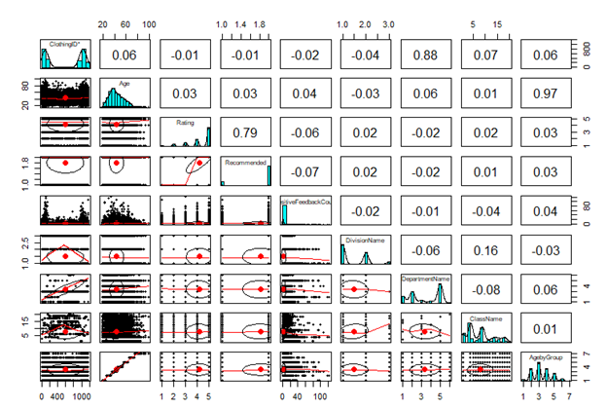
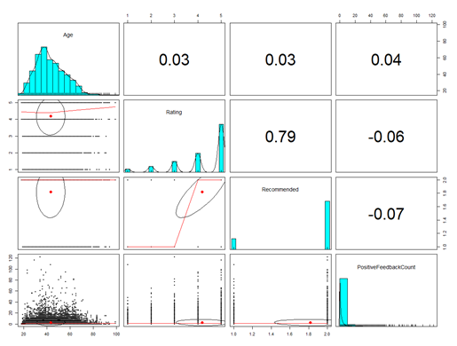
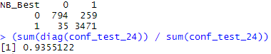
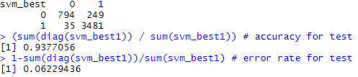
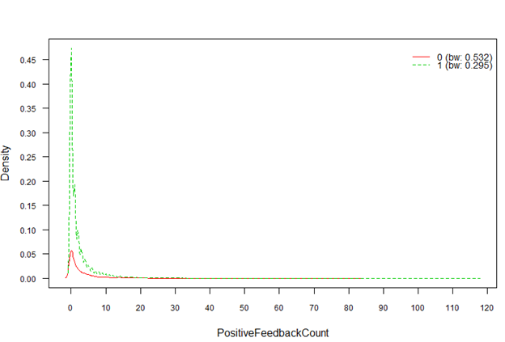
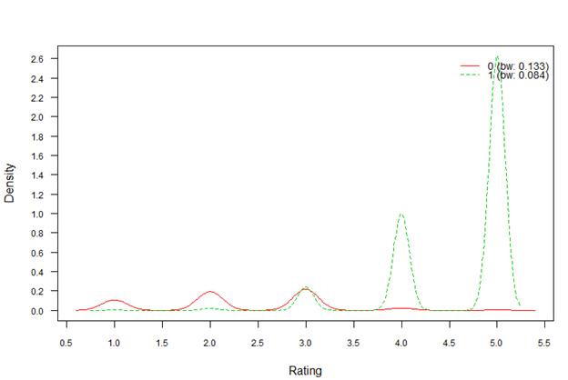
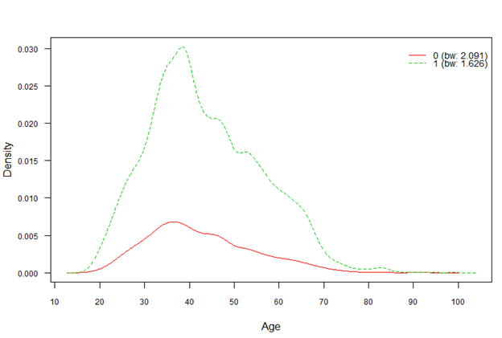
Analysis: Naïve Bayes and SVM Models
Notes:
* A lot of interesting data points in the dataset, but also had some data points that are correlated to each other.
* To take out the noise in the data the dimensionality was reduced to Age, Review Score, AFFIN Score, and Positive Feedback count
*NB_Best has the features of lapace=1 and did not use kernels.
-Kernels would drop the NB by roughly 20% score
*SVM_Best is a linear SVM although radial and polynomial were less then 1 point away. Lowering cost lowered the accuracy, but raising the cost hit the point of diminishing returns super fast from default.
-dataset is only 22k of hundred of millions of transactions, hence; suggest leaving SVM closest to default in order to not over-fit it, for what this dataset is representing
*Interesting learning points form the graphs:
-positive feedback does not mean the review was good but merely folks appreciated the review
-if there is less then ~15 then it is almost always in favor of being recommended
-if a score is a 4 or above almost always is recommended but 3 is a almost 50/50: so targeting those groups to get a bit more positive, so offer great customer service, or prehaps free shipping would be key
To making those form a protractor to an advocate
-also extremely negative scores are a lost of never recommended. Meaning you probably will never shift the strong detractors as much as possibly the middle ground. (you know why politics focus on swing states with big electoral college)
-age range of 30-45 are key stakeholders in recommending reviews

Slide 7
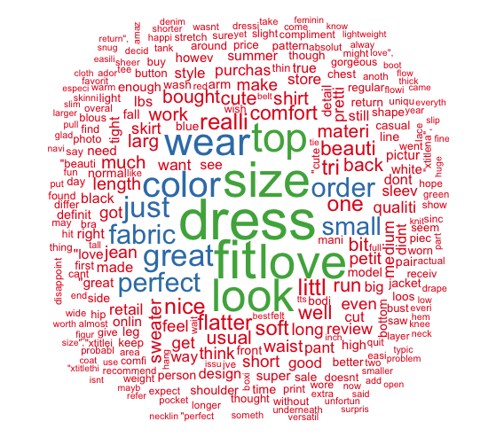
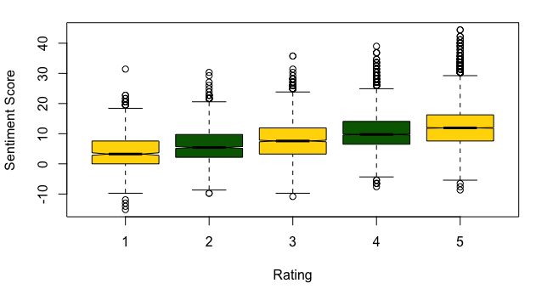
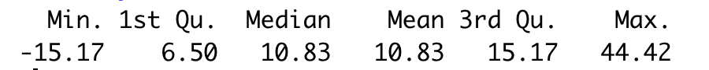
Analysis: Text Mining and Sentiment
Sentiment Scores by Rating
Sentiment Score Statistics
Total Words: 672,170
Notes:
Since the majority of the data was text, this offered interesting insights into the more than 600k words in the reviews. A sentiment analysis was done to ”score” each review. As expected, there is a correlation between a higher score and more positive review, however, some interesting insights emerged as you analyze the conflicting reviews with high scores and low sentiment and vice versa. This will be explored further in the conclusions where suggestions are offered on how to use this information for marketing and customer service improvements.

Slide 8
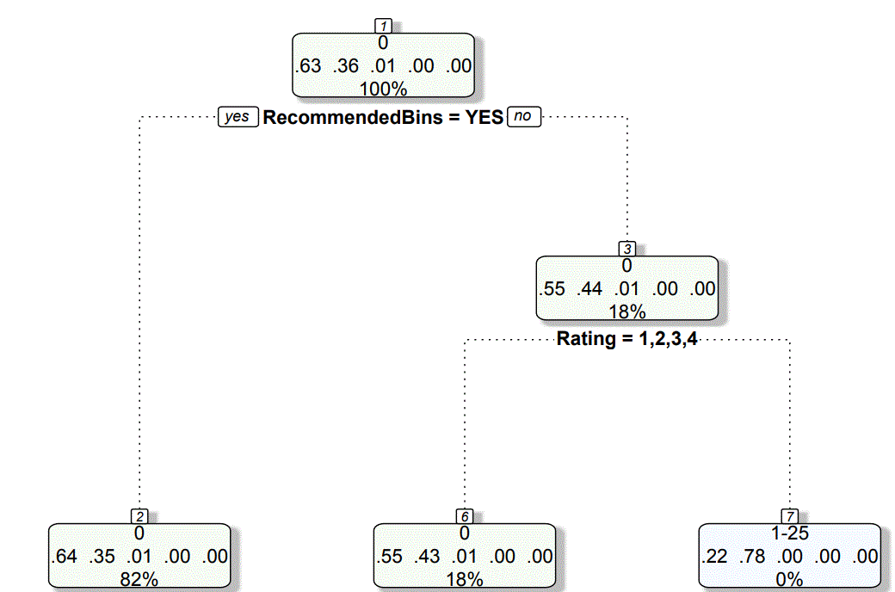
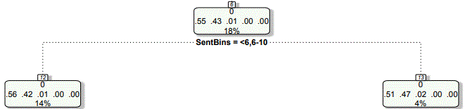
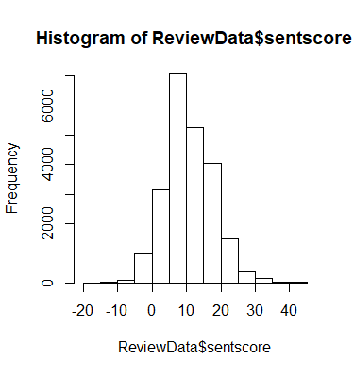
Analysis: Decision Trees
Five Star Ratings & Negative Comments are Most Helpful
Reviews can receive a "thumbs up" as being helpful
1+ Positive Feedback Count
37% of reviews drew a "thumbs up"
Distribution of Positive Feedback
The Helpful Reviews Were Either:
Recommended (82%)
- or -
Got a <5 Star Rating (18%)
The lower rating was accompanied by a lower text review sentiment score 78% of the time (14/18=78)
63% accuracy
Recommended
Not Recommended
Positive Feedback Count | # Reviews
0 | 4256
1-25 | 2457
26-50 | 63
51-75 | 7
76-100 | 6
1-4 Rating
5 Rating
Low Sentiment
High Sentiment
Review Sentiment Scores
Identifying what makes for an impactful review
Notes:
Thanks John. As you mentioned when describing the data ecommerce site visitors were able to indicate if they found a review to be help most likely with a "thumbs up" type button of approval.
Positive feedback was given likely in the form of a "thumbs up" when shoppers used a review in making their purchase. 63% of the reviews have no positive feedback.
Of the 2,500 that did , 8/10 times it was a review that recommended a product
The 2/10 got less than a 5 rating and ¾ of these were reviews that has negative text reviews.
The hypothesis is that the most helpful reviews are those that either let the shopper know details or concerns about a product, or clear the way with a recommendation from previous purchasers.
The decision tree data confirms that the most helpful reviews are giving a shopper a comfort from other shoppers , or specific feedback about why their experience wasn't 5 star.

Slide 9
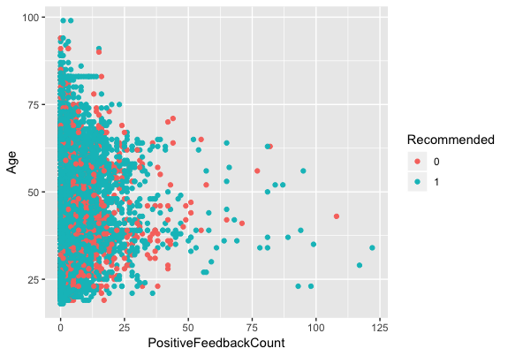
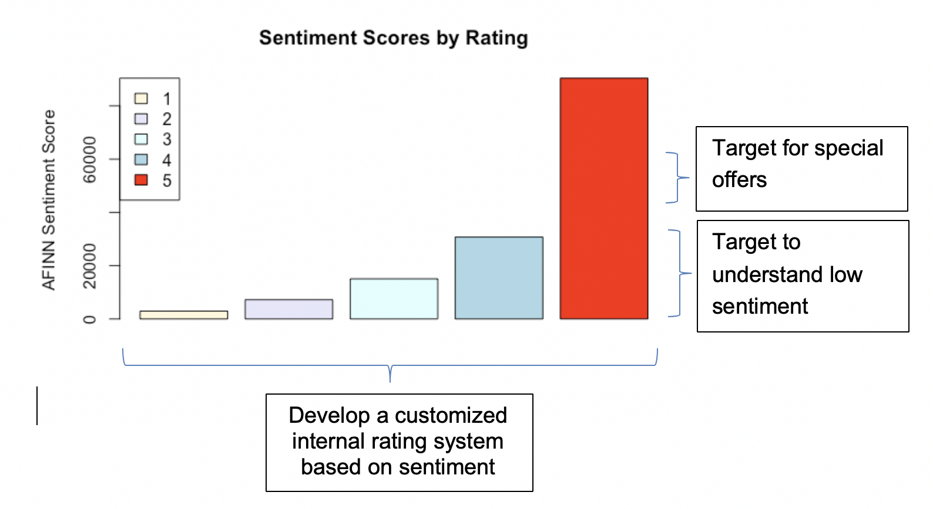
Conclusions and Recommendations Women’s E-Commerce Clothing Reviews
Develop new marketing plan based on…
Age Segmentation - Under 40...Over 40
Sentiment Scores
Target top tier of scores with special offers...
Understand why some 5's have low sentiment scores...
Develop a customized internal rating system based on sentiment
Improve customer service based on Ratings of 3
Implement a verified review process
Notes:
In summary, based on this analysis we recommend
1. A marketing plan around age segmentation,
1. Marketing based on internal sentiment based rating system: those with higher sentiment receiving upsell opportunities with new seasonal lines and premium products
Targeted lower affinity scores would receive specials, discounts or volume purchase promotions.
2. Customer service improvements and contacts with customers giving 3 ratings for potential improvements
3 Seek an improved data set for future analysis that includes customer identification, such as verified reviews, in order to do additional analysis such as co-shopping across product to recommend and provide suggestions like "purchasers of your product also purchased these items"
Those are our conclusions and we welcome any questions.

Slide 10
Works Cited
Kim, D. M. (n.d.). 5 reasons why fashion ecommerce brands will lead retail's growth. Retrieved from https://www.gorilla360.com.au/blog/fashion-ecommerce-retail-growth
Orendorff, Aaron (July 27, 2019). The State of the Ecommerce Fashion Industry: Statistics, Trends & Strategy. Retrieved from https://www.shopify.com/enterprise/ecommerce-fashion-industry
E-Commerce Grows in the Fashion Industry. (2018, November 29). Retrieved from https://www.marketingcharts.com/industries/retail-and-e-commerce-106623
Dimensional Research (2013) The impact of customer service on customer lifetime value 2013. Retrieved from https://www.zendesk.com/resources/customer-service-and-lifetime-customer-value/
Planet Marketing. Why Are Reviews Important? (2019, March 30). Retrieved from https://planetmarketing.com/blog/why-are-reviews-important/#1b

Slide 11
BACKUP SLIDES

Slide 12
Women’s E-Commerce Clothing Reviews Limitations of Study
Reviews are not verified so it is difficult to determine which reviews are potentially fake
Verified review information is not available which would enable linking of reviews to customers (and provide some level of authenticity)
With transaction information on reviewers, cross-sell and up-sell opportunities could be provided to customers

